Slide 1

An introduction to Multi-Variate Pattern Analysis (MVPA) in Python, using scikit-learn & nilearn and The RSA Toolbox
COGNESTIC, 2025
Daniel Mitchell
Daniel.Mitchell@mrc-cbu.cam.ac.uk

Slide 2
Plan for the day
9:05 – 10:00 | Introduction to MVPA Introduction to scikit-learn (and alternative toolboxes) First example – simulated data, with true effect across two voxels
Break
10:15 – 11:00 | Partitions and cross-validation Different classifiers Different output measures Exercises
Break
11:15 – 12:00 | Exercises continued Examples with real fMRI data Which features to use (ROIs, searchlights)? Statistics & permutation
LUNCH
13:00 – 14:00 | Introduction to RSA Introduction to the RSA Toolbox; dataset demos
Break
14:15 – 15:00 | Dissimilarities, RDMs, visualisations
Break
15:15 – 16:00 | More RSA Toolbox demos: Model RDMs, statistics, searchlight
16:30 - | PI talk by Kate Baker
Notes:
https://www.mrc-cbu.cam.ac.uk/events/cognestic-2025/
https://github.com/MRC-CBU/COGNESTIC

Slide 3
Overview
Morning
Introduction to MVPA
What is MVPA?
Why do it?
How does it work?
scikit-learn
What is it?
Why you might want to use it (plus alternatives)
How does it work?
decoding demos focusing on classification, using simulated data and fMRI data
Afternoon
Introduction to RSA
What is RSA?
Why do it?
How does it work?
The RSA Toolbox
What is it?
Why you might want to use it (plus alternatives)
How does it work?
demos using simulated data and fMRI data
Tomorrow: Extension to time & frequency domains (Máté Aller)

Slide 4
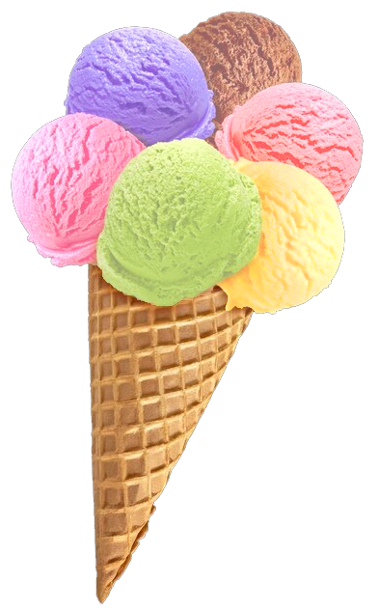
What is MVPA?
“Multi-Variate Pattern Analysis” (MVPA) relates response patterns to experimental conditions
Many (overlapping) flavours
Encoding vs decoding (MVPA can be either or neither)
Activation vs information?
MVB
IEM
cvMANOVA
PCM
RSA
Classification
MVPA
Notes:
For Multivariate Bayes, see e.g. Friston et al., 2008: https://pubmed.ncbi.nlm.nih.gov/17919928/
For Pattern Component Modelling see Diedrichsen et al. 2018: https://www.sciencedirect.com/science/article/pii/S1053811917306985 (this uses priors so is a hierarchical Bayesian model)
For cross-validated MANOVA see Allefeld & Haynes, 2014: https://pubmed.ncbi.nlm.nih.gov/24296330/ (I think this is equivalent to, or a specific case of, PCM)
For Inverted Encoding Models, see e.g. Sprague…Serences 2015: https://www.ncbi.nlm.nih.gov/pmc/articles/PMC4532299/
(IEM and related reconstruction techniques involve predicting multiple experimental features at once)

Slide 5
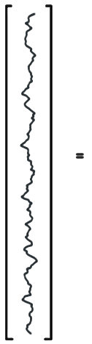
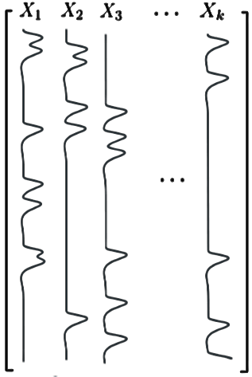
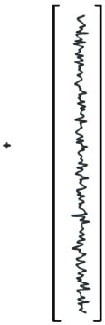
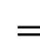
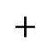

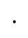
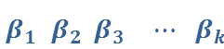
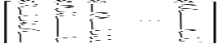
Per voxel (univariate) General Linear Model (GLM)…
…is an encoding model: can we predict the amount of activity in a voxel from the experimental conditions in X?
Activation coefficients
Error
time
(t)
Data (measured BOLD signal)
Design Matrix
In (multivariate) decoding we try to predict the experimental condition from the pattern of responses

Slide 6
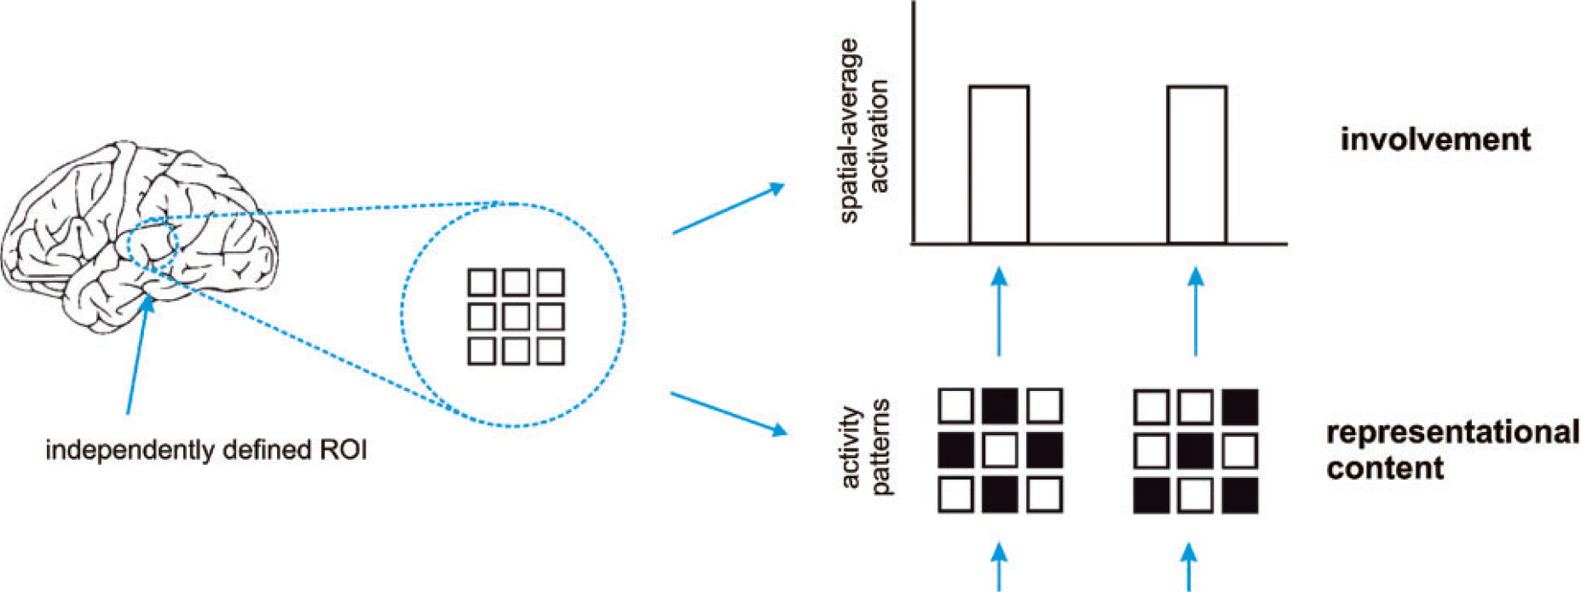
Activation-based (univariate) analysis
Pattern-information analysis
If we can classify experimental conditions based on activity patterns (better than chance)…
Then the activity pattern carries information about the experimental conditions.
Mur et al. (2009)
Notes:
…Real data are noisy, so we need to test whether pattern differences are consistent across repeated presentations…

Slide 7
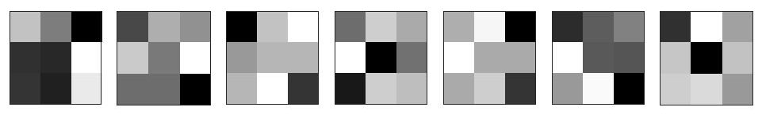
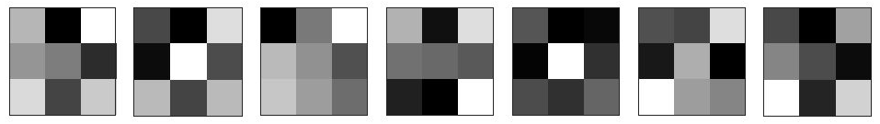
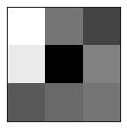
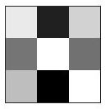
Terminology:
Sample / observation
Label
Class / condition
Patterns
Training set
variable, feature, dimension
(e.g. voxel in fMRI)
Partition /
split /
fold
?
Testing set

Slide 8
Why do MVPA?
Popularity
Scientific questions
What information does a brain region represent? (classification: are patterns reliably different?)
In what format does it represent the information? (RSA: what are distance relations between patterns?)
To make predictions based on brain data
Disease status? Covert thoughts?
Typically more sensitive than univariate analysis
Notes:
Listed in reverse order of importance: It’s the sensitivity that allows interesting questions to be addressed, and in turn this makes it popular.

Slide 9
How does MVPA work? classification example
1
2
Weight vector
Classification boundary
True labels:
?
?
Compare
Voxel 2 activation
?
?
?
Predictions:
Voxel N
Voxel 1 activation
Notes:
Each pattern can be interpreted as a point in space. Each feature (e.g. voxel) represents a separate axis of this space, and values are coordinates. Easiest to visualise in 2 dimensions.
Note – we won’t cover multivariate regression, but it’s conceptually similar: instead of predicting a binary label, the model predicts a continuous label. To evaluate performance, the predicted labels across items in the test set can be correlated with their actual labels.
“To deal with … a 14 dimensional space, visualize a 3D space and say ‘fourteen’ very loudly. Everyone does it.” (Geoffrey Hinton)

Slide 10
Play with SVMs…
LIBSVM:
https://www.csie.ntu.edu.tw/~cjlin/libsvm/

Slide 11
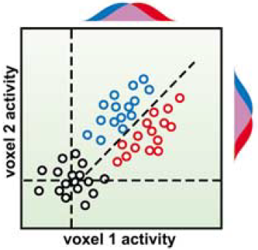
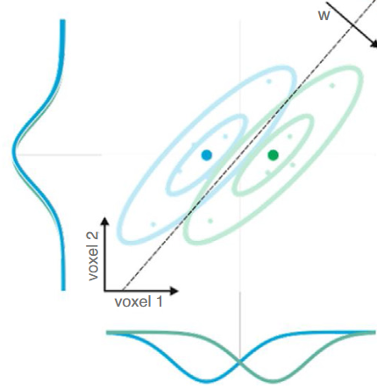
Why can MVPA be more sensitive?
Flexibly combines weak/noisy signal across features (including relative activation, non-uniform responses)
Suppresses correlated noise (Hebart & Baker 2018; interpreting weight vector is tricky: Haufe et al., 2014)
Abstracts from subjects’ idiosyncratic response patterns (information versus activation)
Cox & Savoy (2003)
Kriegeskorte & Douglas (2019)
SUBJECT A
SUBJECT B
Voxel 2
Voxel 2
Voxel 1
Voxel 1
Notes:
Point 2 implies that it can be useful to include “noise voxels” in the pattern (to the extent that noise is correlated).
Note that MVPA is not always more sensitive. Requirement for cross-validation means that 1) model does not use all data at once and 2) there is a risk of overfitting. Univariate analysis on smoothed/averaged data might be more sensitive if its assumptions of homogeneous and consistent activation are correct. (See e.g. Kriegeskorte 2006)

Slide 12
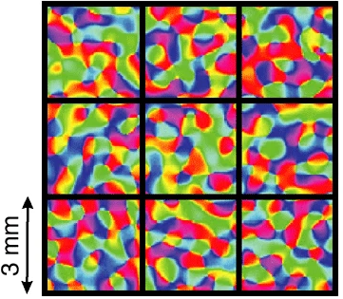
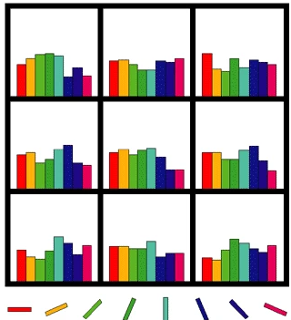
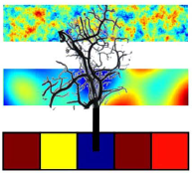
Physiology: fine or coarser scale patterns?
Original view: biased sampling of sub-voxel patterns
Later spatial filtering experiments:
Removing high spatial frequencies doesn’t always hurt (e.g. Op de Beeck, 2010; Hendriks, 2017)
Therefore sampled patterns may be coarse
Much evidence that information is represented at multiple scales (e.g. FFA/PPA, Haxby 2001; radial orientation bias, etc.)
Veins as multipronged sensors? (We sample from veins, which sample from neurons)
Often unimportant… (we want to ask “is there information?” not “what scale is the information?”), but could have practical consequences (consider smoothing and motion)
Kamitani & Tong (2005)
Haynes & Rees (2005)
Boynton (2005)
Kriegeskorte et al. (2009)
Notes:
Orientation column in human is about 0.8mm diameter (Yacoub 2008)
In general, the matched filter theorem (see Rik’s session) implies that it is optimal to smooth your data with a kernel matched to the spatial resolution at which you think your experimental feature is encoded in the brain patterns.

Slide 13


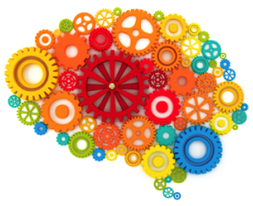

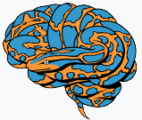
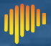

Many MVPA toolboxes are available…
Matlab (or Octave) | Python
CoSMoMVPA http://cosmomvpa.org/ | PyMVPA http://www.pymvpa.org/
The Decoding Toolbox sites.google.com/site/tdtdecodingtoolbox/ | MNE-python (for EMEG) https://mne.tools/stable
PRoNTo (for SPM) http://www.mlnl.cs.ucl.ac.uk/pronto/ | NiLearn (general/fMRI) https://nilearn.github.io/stable
Princeton Decoding Toolbox (discontinued) | BrainIAK (+advanced non-MVPA) https://brainiak.org/
MVPA-Light, https://github.com/treder/MVPA-Light
Searchmight (focus on searchlights) http://www.franciscopereira.org/searchmight/
Built-in functions | General ML packages e.g. https://scikit-learn.org/
RSA Toolbox (focus on RSA) https://git.fmrib.ox.ac.uk/hnili/rsa https://github.com/rsagroup/rsatoolbox
Within larger packages (e.g. BrainVoyager; MNE; 3dSVM in AFNI)
Yet more in Matlab: MANIA, MANAS, MVPANI, Brain Decoder Toolbox 2…
...

Slide 14
Why use scikit-learn?
Pros:
Open source (Python)
Popular: basis of many more specialised toolboxes
“Simple and efficient”
Built on standard packages (Numpy, SciPy, matplotlib)
Good documentation, and examples: https://scikit-learn.org/stable/
Extensive and actively developed
Limits:
Not specialized for neuroimaging data (but integrated with neuroimaging packages, like nilearn)
Doesn’t have deep learning capabilities (not needed for typical neuroimaging applications)
Parallelization not straightforward

Slide 15
Activating the environment for these demos:
Start the Virtual Machine; open a Terminal; then activate the environment using: conda activate mri
This includes the following packages that we will use in these demos:
numpy (so python can process arrays, like Matlab)
matplotlib (so python can plot graphs like Matlab)
seaborn (extra plotting functions, based on matplotlib)
pandas (to use “dataframes” – like tables in Matlab)
nilearn (many useful functions for loading/processing/viewing MRI data)
scikit-learn (major, general-purpose machine learning package)
os (to interact with operating system)
time (to access system clock)
rsatoolbox (for this afternoon)
Start jupyter lab from the COGNESTIC folder, and find the current notebooks: cd COGNESTIC/ jupyter lab (or jupyter notebook)
Open “/09_MVPA_MRI/Decoding/DECODING_demo_djm_2025.ipynb”
Important!
To demo!
Notes:
To start VM:
- go to labs.azure.com (https://labs.azure.com/virtualmachines)
- (Reset password if needed, e.g. first time or if re-imaged)
- Start machine if not running;
- Connect via RDP (can save and reuse link)
scipy can load .mat files with io.loadmat and adds other matlab functionality like squareform and standard statistics (e.g. t-tests)
glob to search filenames with wildcards (not used here)
collections provides extra datatypes e.g. defaultdict
nibabel can process analyze/nifti files with load() and load().get_fdata
Can do: from [package] import [module] as [newname]
To use VScode:
Install Remote SSH
Click green button at bottom left; connect current window to host
Enter e.g. dm01@login-j03 + password
“conda env list” to see available environments
“conda list” to see software in active environment
Note: important to start jupyter lab in the COGNESTIC folder, to have access to data in module 06.

Slide 16
Python(+Numpy) vs Matlab/Octave
Python(+Numpy) and Matlab/Octave are both high-level programming languages with many similarities
But note some differences:
If unsure, just ask! (or Google e.g. “numpy-for-matlab-users”)
Python | Octave/Matlab
Zero-based indexing, with [ ]: e.g. a[0:3] returns first 3 elements of a | One-based indexing, with ( ): e.g. a(1:3) returns first 3 elements of a
Transpose with: a.conj().T | Transpose with: a’
Comment with # | Comment with %
Print values with: print(a) | Print values with: a, or disp(a), or fprintf( ‘%g’ , a)
Loop with e.g.: for i in range(1, 4): # indented code | Loop with e.g.: for i = 1:3 % optional indent end
Can store arbitrary items in a list, e.g.: a = [10, “hello” ]; get last item with: a[-1] | Can store arbitrary items in cell array, e.g.: a = {10, “hello” }; get last item with: a{end}
Get help with: func? | Get help with: help func

Slide 17
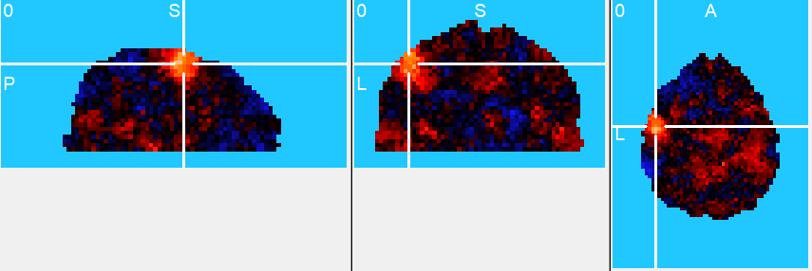
An example dataset/experiment
single participant
2 conditions: thumb vs index finger right-hand button presses, in alternating blocks, each lasting 16 s.
4 fMRI runs with 3 repeats of each condition per run
→ 4 x 3 x 2 = 24 volumes of beta coefficient (or t-value) maps
We might ask – where in the brain is there information about which finger is moving?
Or – in a region of interest, is there information about which finger is moving?

Slide 18
An example dataset/experiment
Where in the brain is there information about which finger is moving?
What choices do we need to make to produce this output?
Which voxels will we include?
How will we partition/cross-validate?
Which method/classifier will we use?
Which output measure will we use?
(Also, choice of pre-processing etc…)
What question should we ask next?
Is the information significant?
for this participant?
on average across participants?

Slide 19
Partitions, classifiers & metrics
Partition schemes, for cross-validation, e.g.:
“hold out” (e.g. odd/even split)
“k-fold” (repeated? grouped? stratified?)
“cross-generalisation”
...
Classifiers, e.g.:
Logistic regression (LR)
Fisher’s Linear discriminant analysis (LDA)
Support vector machine (SVM)
Gaussian naïve Bayes (GNB)
K-nearest neighbour (k-NN)
...
Performance metrics, e.g.:
‘accuracy’, ‘balanced accuracy’, ‘area under ROC curve’, ‘d prime’, ‘mean probability of true class’, ‘mean signed distance to hyperplane’, ...
Notes:
(Coffee break around here?)

Slide 20
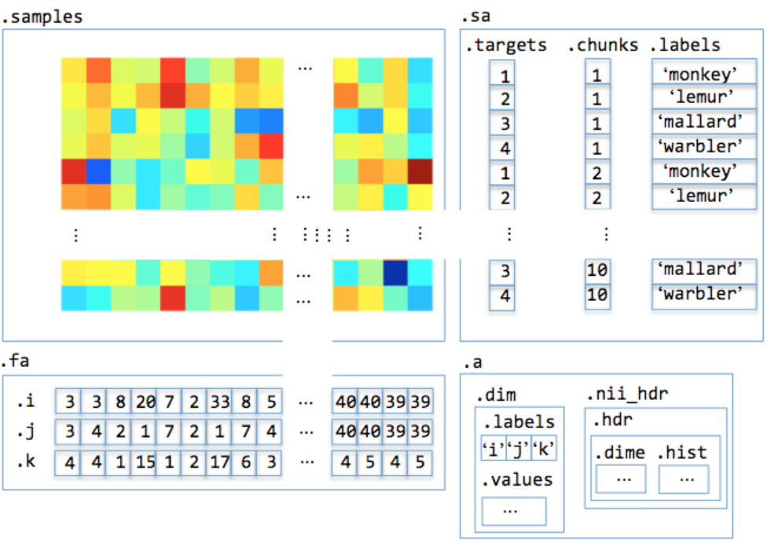
Basic “data set” structure:
How does MVPA work?
“features” (e.g. voxels)
sample “attributes”
E.g.:
condition label;
run number
“samples”
data set attributes
E.g.:
volume dimensions;
subject number
feature attributes
E.g.: voxel coordinates
Back to demo!
Notes:
This example is from CosmoMVPA, but same basic idea applies in general.
Foe decoding, we provide the “labels” vector, which makes this “supervised” learning.
What sample attributes can you think of?
What feature attributes can you think of?
What dataset attributes can you think of?
For fMRI, features might be surface nodes rather than voxels.
For EMEG, features might be sensors and/or timepoints and/or frequency bands
Samples can be defined as GLM estimates (per trial, or per condition etc.) or time-points.
Getting all samples from a single GLM is sometimes called the Least-squares all (LSA) approach.
The least-squares separate (LSS) design involves fitting a separate model per trial. Each model contains one regressor for the trial that you want to estimate and, for each condition in your experimental design (in case of a categorical design), another regressor containing all other trials.
(See Mumford et al. & Abdulrahman & Henson, 2016.)
(The “nibetaseries” package could be considered for trial-wise estimates in python.)
It’s not obvious which is best: “ratio of trial-to-trial variability to scan noise impacts both the optimal SOA and optimal GLM, especially for short SOAs b 5 s: LSA is better when this ratio is high, whereas LSS [is] better when the ratio is low.”
Soch et al 2020 looks like an interesting alternative method to account for correlation between overlapping regressors? (Adjust patterns matrix R, by calculating: (X^{T}X)^{0.5}R )
If using GLM, could use t-stats instead of beta/contrast estimates to implement univariate noise normalisation.

Slide 21
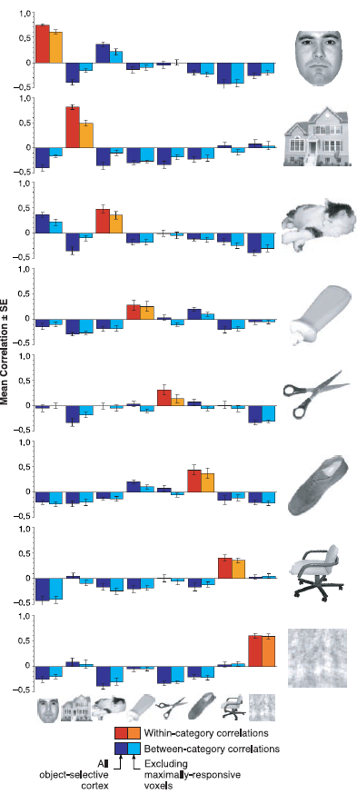
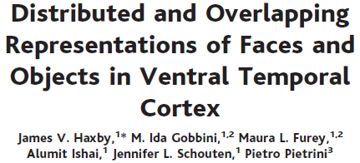
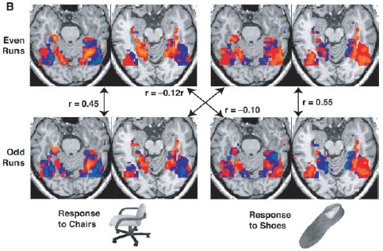
Notes:
Many of the examples in the CoSMoMVPA toolbox use this approach.
It’s fast and sensitive, but outperformed by other classifiers e.g. SVM. (See e.g. Haxby et al 2011; Haxby 2012), so we won’t use it here.
It can be thought of as 1-nearest neighbour classification, using correlation as a distance measure and one particular partition.

Slide 22
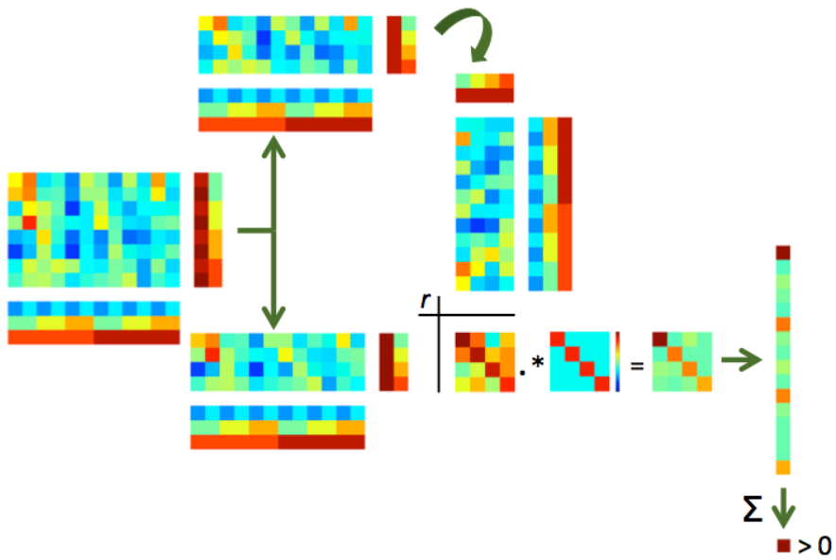
Schematic of “Haxby-style” split-half correlation approach:
Notes:
Figure from CoSMoMVPA

Slide 23
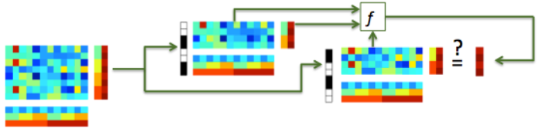
Typical classification uses multiple samples per class – by characterising the covariance of responses it is potentially more sensitive than split-half correlation analysis
Typical classifiers use Euclidean rather than correlation distance, which is invariant to shifts and rotations, and has a well-defined noise distribution.
Notes:
Figure from CoSMoMVPA

Slide 24
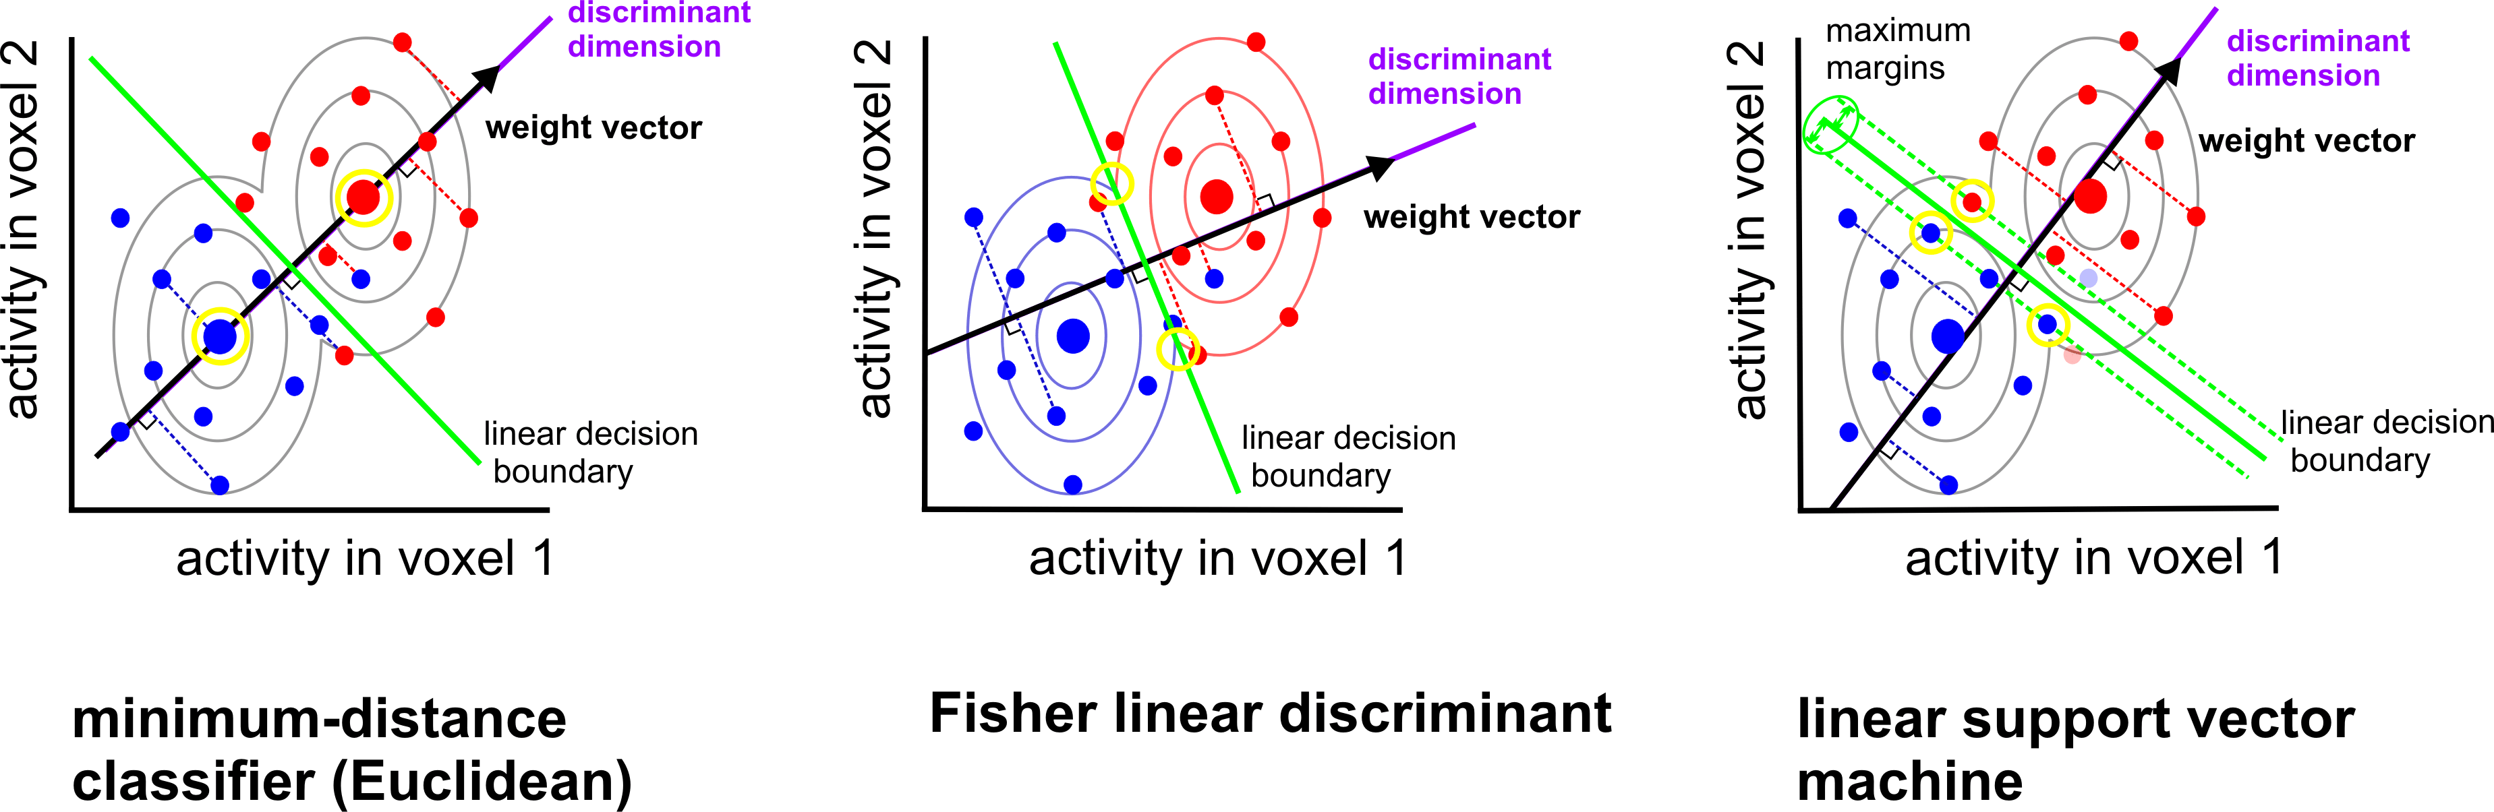
Boundary placement: some linear classifiers
(AKA LDA) assumes identical and multivariate normal distributions (need to estimate covariance)
(AKA centroid-nearest neighbor)
assumes identical and isotropic distributions
no assumptions about distributions
(need to choose C, or nu)
Mur et al. (2009)
Notes:
LDA is equivalent to Linearly Constrained Minimum Variance Beamformer?
Another option is logistic regression (LR)
GNB, LDA and QDA are generative/parametric models.
Logistic regression (LR) & linear SVM are discriminative models. SVM has a hinge loss, whereas LR has a smoother loss.
Nearest neighbour classifiers are simpler in that no parameters are learned, but require a choice of distance metric and of neighbourhood definition
For the SVM (and similarly LR), decreasing C increases regularisation, which means that more datapoints become support vectors. For neuroimaging, with typically more dimensions than samples, all datapoints are support vectors anyway, so this has minimal effect. It also has less effect for the standard L2 penalty than an L1 penalty (See Varoquaux et al., 2017).
(Note that an L1 loss for neuroimaging data would typically lead to unstable voxel selection because of spatial autocorrelation (selecting a random subset of similar voxels.)

Slide 25
Which classifier is best?
Will depend on:
how well each classifier’s assumptions are met
how much data are available
desired inference/interpretation
Linear SVM and Fisher linear discriminant (with shrinkage covariance estimator) often perform well for fMRI data.
Misaki et al. 2010; Pereira 2011
Notes:
LDA can do simultaneous multiclass classification, but SVM needs to combine pairwise classifications.
Covariance matrix estimation can be slow, especially for many voxels.
So with few voxels and many classes, perhaps prefer LDA? With few classes and many voxels, perhaps prefer SVM?
They will also differ somewhat in their sensitivity to outliers.
LDA gives a more direct measure of class membership probability

Slide 26
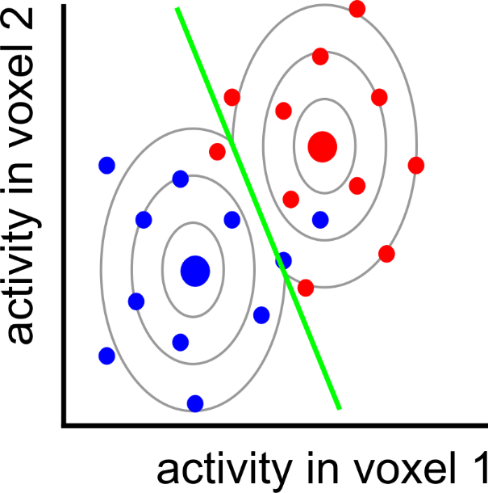
Can we do better?
Notes:
Here is the LDA classifier from before, fit to the training data. It has made three mistakes.

Slide 27
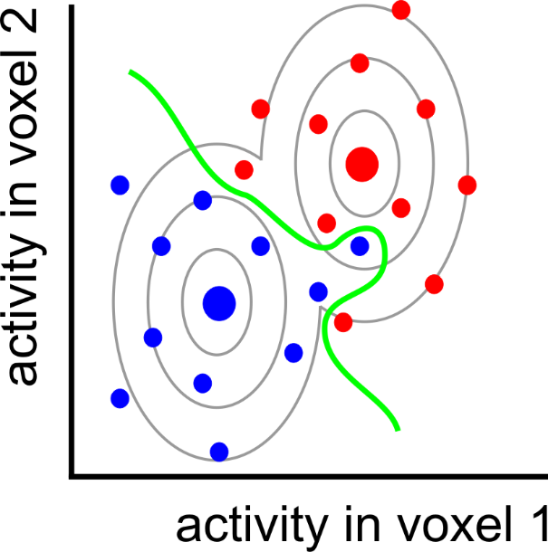
nonlinear
classifier

Slide 28
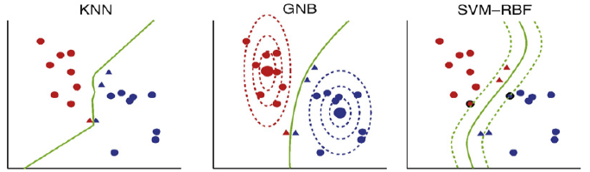
Some non-linear classifiers
K-nearest neighbour
(Quadratic)
Gaussian Naïve Bayes
SVM with radial/polynomial/sigmoid basis function
Nonparametric (need to select k, and distance metric)
Assumes multivariate, but non-identical, normal distributions
(“Naïve” because ignores voxel correlation; otherwise QDA)
No assumptions about distributions
(need parameter selection)
Misaki et al. 2010

Slide 29
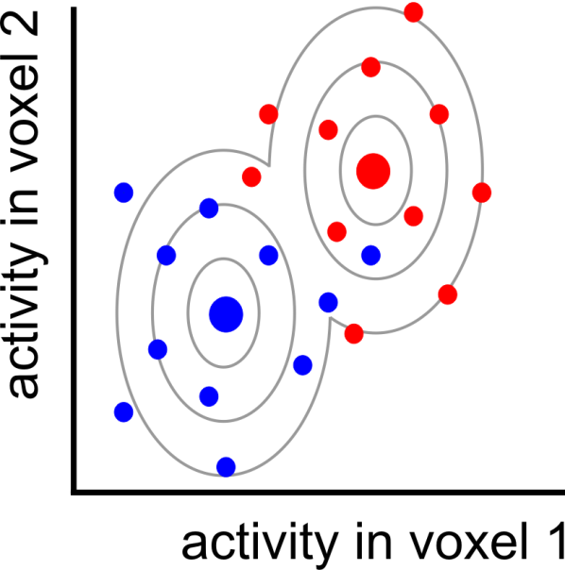
Pattern = signal + noise

Slide 30
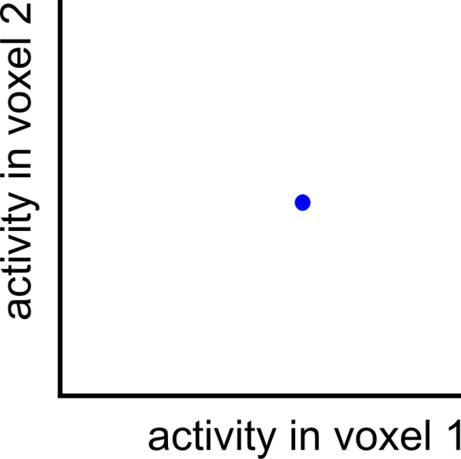
Pattern = signal + noise
measured pattern
(signal + noise)

Slide 31
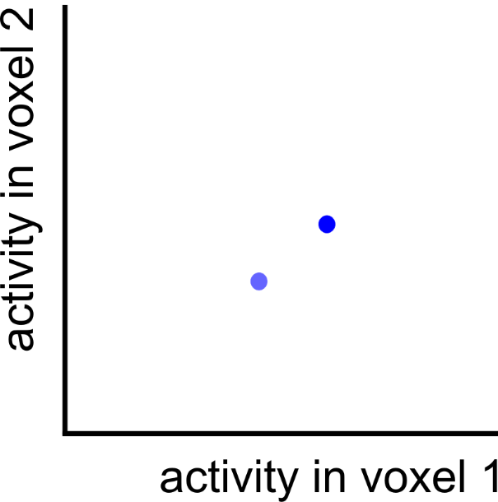
Pattern = signal + noise
measured pattern
(signal + noise)
true pattern
(signal)

Slide 32
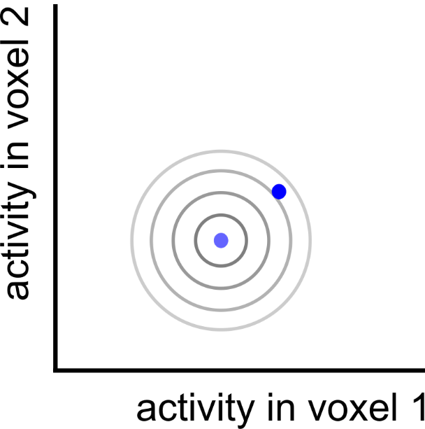
Pattern = signal + noise
measured pattern
(signal + noise)
true pattern
(signal)

Slide 33

Pattern = signal + noise
measured pattern
(signal + noise)
true pattern
(signal)
noise displacement

Slide 34
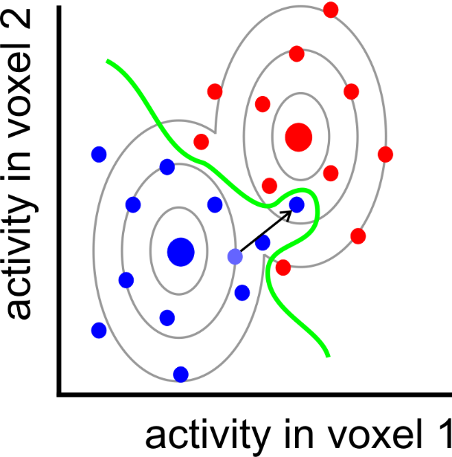
Overfitting

Slide 35
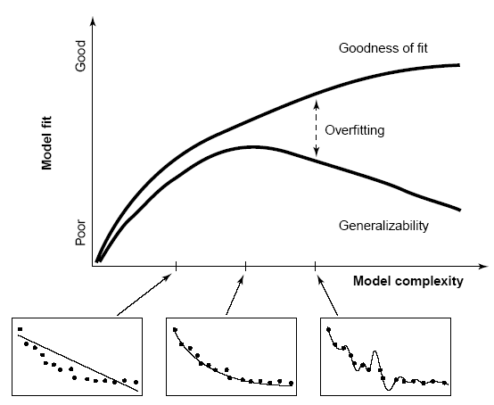

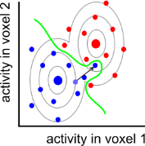
Overfitting & cross-validation
After determining the decision boundary, we need to test how well the boundary generalises to new data (cross validation), expected to have the same signal, but different noise.
Classifier accuracy will be inflated, if it’s not cross-validated
Linear classifiers usually outperform nonlinear classifiers on fMRI data.
Overfitting can be further reduced by:
regularisation
reduce dimensionality of activity patterns (e.g. voxel selection or PCA)
increase sample size
(training data)
performance
(held-out test data)
boundary complexity
Notes:
Regularisation: use prior assumptions to constrain the ways in which the boundary is shaped and shifted so as to discriminate the categories in the training data.
See Poldrack et al 2020 for simulations of overfitting as functions of model order, number of variables, and sample size.
Reduced dimensionality can also be achieved by “sparse random projection”, while preserving pairwise sample distances. (See Johnson-Lindenstrauss lemma)

Slide 36
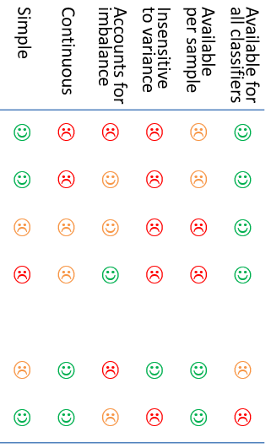
Performance measures
Possible pros/cons:
Several options, with pros/cons e.g.:
Accuracy (proportion correct classifications)
Accuracy per class (balanced accuracy)
D-prime (and other sensitivity measures)
Area under ROC curve
Decision variable
e.g. signed distance from margin
Probability of correct classification
Simple | Continuous | Accounts for imbalance | Insensitive to variance | Available per sample | Available for all classifiers
☺ | ☹ | ☹ | ☹ | ☹ | ☺
☺ | ☹ | ☺ | ☹ | ☹ | ☺
☹ | ☹ | ☺ | ☹ | ☹ | ☺
☹ | ☹ | ☺ | ☹ | ☹ | ☺
☹ | ☺ | ☹ | ☺ | ☺ | ☹
☺ | ☺ | ☹ | ☹ | ☺ | ☹
Notes:
(Table converted to image because otherwise it flickers during other animations)
A simple Pearson correlation between the binary vectors (aka Phi, or Matthew’s correlation coefficient) might be even better than AUROC in terms of simplicity/intuitiveness and sensitivity (see e.g. Chicco & Jurman, 2023), but might not be suitable for imbalanced classes (Zhu, 2020). Wikipedia also says “if MCC equals neither −1, 0, or +1, it is not a reliable indicator of how similar a predictor is to random guessing because MCC is dependent on the dataset” (see Chicco et al 2021).

Slide 37
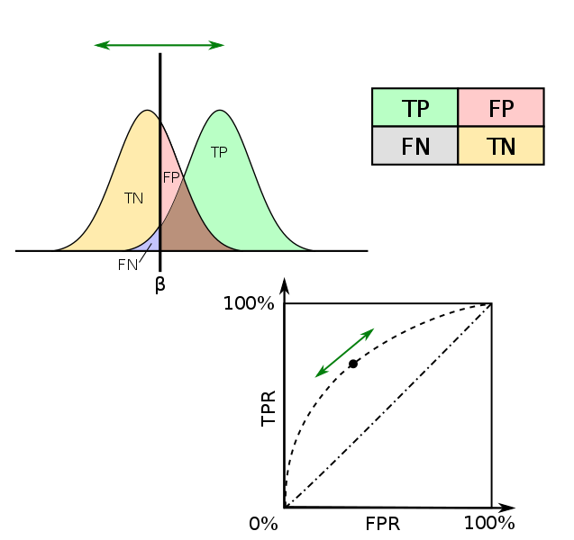
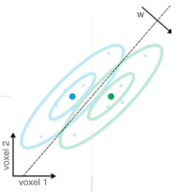
Signal detection theory, and ROCs
Estimated:
Criterion
d’ (sensitivity)
Chance = 0
Measured:
Hit rate
False alarm rate
Assumed:
Correct rejection rate
Miss rate
ROC (Receiver operating characteristic)
AUROC (area under ROC) Chance = 0.5
Notes:
Two theoretical normal distributions of evidence, for class A and class B, along a dimension of “A-ness”.
By measuring the proportions of hits, misses, Fas and CRs, we can estimate the separation of the distributions (sensitivity, d’) and the decision criterion (bias).
Thus signal detection theory makes parametric assumptions and estimates a single criterion.
The ROC maps out the performance (ratio of hit rate to FA rate) non-parametrically, as a function of the criterion.

Slide 38
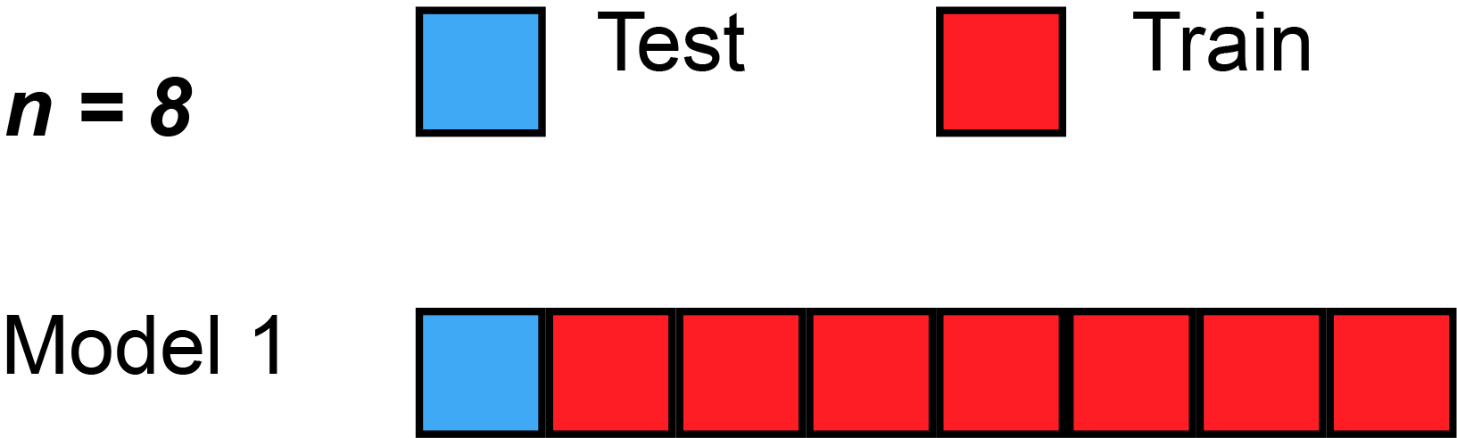
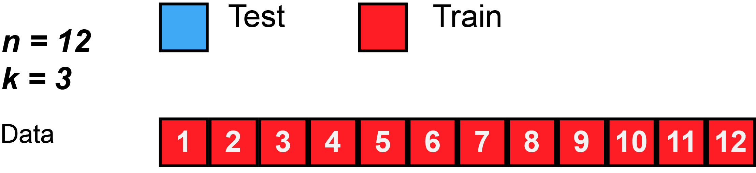
Data splitting/partitioning
Holdout/validation set from single context
Safe but often not efficient/stable
Separate datasets from different contexts (“cross-classification”, “cross-generalization”)
used to test generalization & demonstrate common format (e.g. train on perception, test on imagery; train at time-point 1, test at time-point 2)
Cross-validation within full single dataset
Reuse data for both training and testing in different splits/folds
Average performance across folds
“split half”…
…“k-fold”…
… “leave-one-out”
Training and testing data should be independent within a fold (“decoding step”), but will be dependent across folds
Ideally want conditions balanced within each chunk
More ways to split… more precise performance estimate
More training data per split… more sensitive
Gifs from Wikipedia

Slide 39
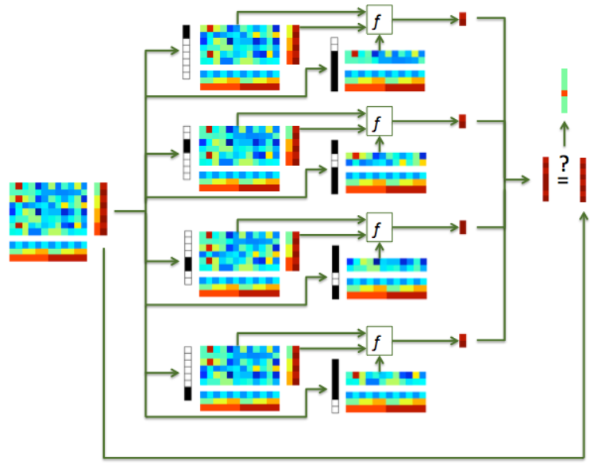
Data splitting/partitioning

Slide 40
Cross-validation granularity: generalise to….?
new trial/stimulus pair (leave-stimulus-pair-out)
new run (leave-run-out)
new subject (leave-subject-out)
(“hyperalignment”, Haxby, 2011; 2020)
Why do we need out-of-sample prediction at all?
Classical univariate analysis uses within-sample statistical estimation (activation can be estimated in a direct and unbiased way)
In MVPA we want to estimate “information”, and out-of-sample prediction provides an unbiased estimate of this (with minimal assumptions).
Fewer samples
Cleaner samples
More different distributions
More independence

Slide 41
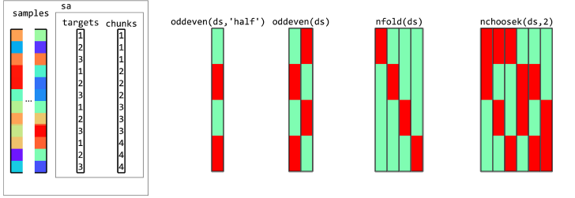
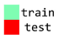
Some different ways to partition samples:
Examples with 3 conditions (targets) in each of 4 runs (chunks):
Each column is a classifier
Per column, samples from a run/chunk are never in both train AND test
Accuracy typically averaged across columns
Could combine classifier that use different proportions of test data
No need for a classifier to use all the data...
Oosterhof et al. (2016)

Slide 42
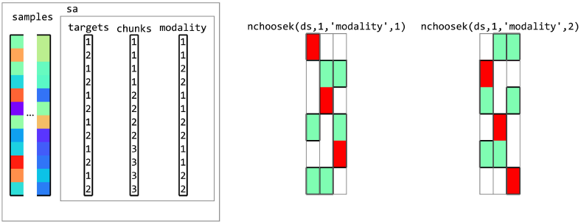
Partitions that “cross-generalise”
Example with 2 conditions (targets) in each of 3 runs (chunks), cross-generalized across “modality”:
(Could similarly cross-generalize across participants, or time points)
Oosterhof et al. (2016)
Back to demo!
Notes:
(Coffee break around here?)

Slide 43
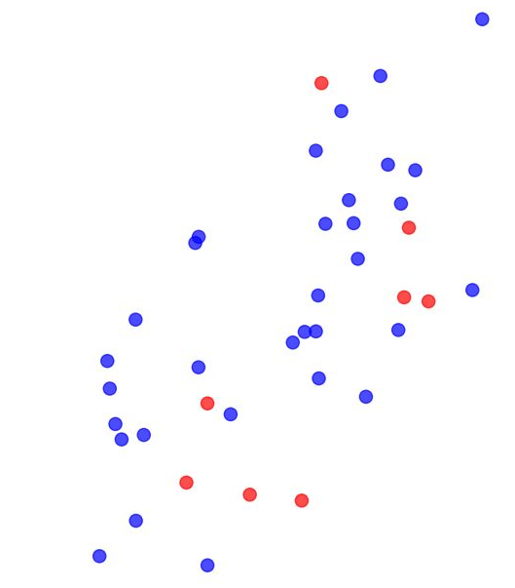








The RED exercise: No true pattern difference, but high classification performance
The ORANGE exercise: A true pattern difference, but disappointing classification performance
The GREEN exercise: No mean pattern difference, but high classification performance
The BLUE exercise: Significantly below-chance classification performance
Notes:
(emojis from bluemoji.io)

Slide 44
Unbalanced samples
A classifier that doesn’t look at the test data should be at chance (on average)
In this case, what is the expected proportion of correct classifications (accuracy) for N balanced classes?
But what will happen if there are more samples from class A than class B (in both test and train sets)?
What could we do about this?
Design the experiment to collect balanced data
Resample the data at each fold to restore balance
Tell the classifier to re-weight the samples to adjust for imbalance
Use an output measure that is unbiased for unbalanced data
This last one is orthogonal to the others, and is always a good idea in case attempts to balance the samples are imperfect. However it doesn’t stop the classifier being biased, it just ensures this bias does not propagate to the performance metric.

Slide 45
The RED exercise - Unbalanced samples; no true signal
Imagine a case with few samples in a red class and 4x as many in a blue class, but both randomly sampled from the same distribution:
A classifier that uses the class proportions will be biased to choose blue.
Here, the classifier always predicts blue and is correct 4/5 of the time, even if no true signal:
“Simple accuracy” = 80%
Averaging “accuracy per class” corrects for the bias without changing the boundary, which is still biased:
In this example, Blue accuracy = 100% Red accuracy = 0% Average = 50%
Subsampling the majority class will discard some data, but encourages unbiased placement of the decision boundary:
“Simple accuracy” = “accuracy per class” ~ 50% ±

Slide 46

The ORANGE exercise - Unbalanced samples; true signal
Again imagine a case with few red samples and this time 9x as many blue samples, this time drawn from different distributions:
Without subsampling, the classification boundary will be somewhat biased to choose blue.
In this example, the classifier always predicts blue and is correct 90% of the time:
“Simple accuracy” = 90%
Averaging “accuracy per class” corrects for the bias without changing the boundary, which is still biased (suboptimal): Blue accuracy = 100% Red accuracy = 0% Average = 50%
…despite some true signal
Subsampling or reweighting the majority class will discard some data, but can improve sensitivity by encouraging optimal placement of the decision boundary:
“Simple accuracy” = “accuracy per class” > 50%

Slide 47
The GREEN exercise – patterns with same mean, but different variance
d
A non-linear classifier (e.g. SVM with radial basis) can partially separate classes based on their variance:
Red accuracy = 100% Blue accuracy >> 0% Average >> 50%
A linear classifier can still achieve above-chance performance using a metric based on the proportion correct: Red accuracy = 100% Blue accuracy > 0% Average > 50%
Other metrics can be insensitive to sample variance:
e.g. mean signed distance to hyperplane:
d – d = 0 = chance

Slide 48
Summary of some related principles:
 | Problems that might inflate performance (assumed to reflect real mean pattern differences):
 | Bias due to overfitting | Bias due to unequal class probability | Bias due to unequal class variance
Solution to reduce bias in classifier | Use a simpler model: fewer features fewer parameters more regularisation | Reduce imbalance in training set: by design by resampling by reweighting | Try to match class variance by design Use a classifier that’s less sensitive to class variance (e.g. linear rather than nonlinear)
Solution to remove bias from performance metric | Cross-validate | Use a metric that is insensitive to class probability, e.g.: Balanced accuracy Area under ROC curve Ensure test set is balanced | Use a metric that’s insensitive to pattern variance, e.g.: Mean signed distance to hyperplane

Slide 49



The BLUE exercise: below-chance decoding
Run 1
Run 2
Run 3
Run 4
Run 5
Run 6
Run 7
Run 8
100%
8 runs
2 activation patterns per run, in response to coloured fruits
Fruit & colour fully counterbalanced across the experiment
One of each fruit, and one of each colour, per run
Leave-one-run-out cross validation
Significantly below-chance decoding of fruit (apple vs pear)
50% (chance)
0%

Slide 50
The BLUE exercise: below-chance decoding
Run 1
Run 2
Run 3
Run 4
Run 5
Run 6
Run 7
Run 8
Train
Test
Within each run, features are balanced but not counterbalanced
Across the full experiment, features are counterbalanced, but with leave-one-run-out cross-validation, each training set is unbalanced
In this example fold, the classifier learns that apples tend to be blue
The test set has the opposite imbalance
So a classifier that’s more sensitive to colour will tend to guess wrongly for shape
Here the problem can be solved by choosing test sets (and therefore train sets) that are fully counterbalanced (e.g. test on runs 7 & 8)

Slide 51
Specific considerations for fMRI data
Temporal autocorrelation:
Dependencies between patterns within a run
Safest for test/train patterns to come from different runs
Pre-processing:
Similar to standard univariate analysis
Probably:
motion-correction
Slice-scan-time correction
Possibly:
normalisation to template space (e.g. if random-effects searchlight analysis across subjects; could come after classification)
Slight spatial smoothing (could increase or decrease SNR, depending on spatial scale of signal vs noise)

Slide 52

With many features, we need to choose, which of them we want to use
Voxel selection must be based on data independent from test data set (not specific to MVPA!)
Choice of which features to use determines:
inference that can be made;
SNR/risk of overfitting
Most common ways of voxel selection:
structural ROI (anatomy; e.g. traced per subject, or from an atlas)
functional ROI (activity; e.g. from per-subject localizer, or coordinates from literature)
univariate (activation differences)
multivariate (pattern differences)
“Searchlight” (roving ROI; often local/contiguous, but needn’t be)
“whole brain” (global ROI; more for prediction applications)
Could do this at same time as training the model, but would need nested-cross-validation (complicated, slow, and loss of training data may outweigh any benefits)
Kriegeskorte et al.
2006

Slide 53


The first searchlight paper
Example comparison of activation-based and information-based mapping
Kriegeskorte et al. 2006, 2007

Slide 54
Selecting voxels, continued
How many voxels?
Depends on the expected spatial extent of effects, and the scientific question.
few → risk of missing signal
many → risk of overfitting (too noisy) & weaker localization
Might information be distributed across non-contiguous regions?
Sometimes people select the same number of voxels in each subject, and for each region of interest.
But beware direct comparisons between regions! (Equating voxel number doesn’t make them equal; e.g. MT neurons might encode motion more strongly than V1/V2, but decoding is weaker because neurons are more finely intermixed. Often important to consider interaction with condition.)
Back to demo!

Slide 55
Statistical inference
Dominant in the literature:
Random-effects analysis across subjects, using standard one-sample right-sided t test.
H₀: μ = 50% (for balanced 2-class); H_{a}: μ > 50%
Is this valid?
observations (i.e. subjects) are independent
reasonable to assume probability distribution of classification accuracy is identical across subjects
number of subjects is large enough for the central limit theorem to apply (can assume sampling distribution approaches a normal distribution)
But, take care over chance level (especially for unbalanced classes)
If any doubt, can use permutation test instead; wise to include negative control
If true value of dependent measure cannot be negative, t-test only provides FFX inference (Allefeld et al. 2016)

Slide 56

Statistical inference
Error variability
across folds (Non-independent: probably invalid)
Error variability
across subjects (Independent: probably valid)

Slide 57



Statistical inference
subject-average
classification accuracy
If the computed t value falls within the top 5% (blue) of the t distribution → reject H₀.

Slide 58
Statistical inference
However:
are we sure that the accuracy is 50% under H₀?
What about stats within a subject?
→ use a permutation test:
create null distribution by randomly shuffling condition labels many times (1000-10,000) before training
remove relationship between labels and patterns
assumes data are exchangeable (H₀: all classes come from same distribution)
But:
slow;
permutations limited by number of samples/classes (insensitive)
complicated: permutations must preserve balance/autocorrelation

Slide 59


Statistical inference
Null distribution of subject-n classification accuracy

Slide 60

Statistical inference
If the actual classification accuracy falls within the top 5% (blue) of the null distribution → reject H₀.
Back to demo!

Slide 61
Lunch time!

Slide 62
A small selection of influential/interesting papers and example applications…

Slide 64






Slide 65




Slide 66





Slide 67






Slide 68



Slide 69



Slide 70





Slide 71



Slide 72



Slide 73
References (a selective list)
Linear classification tutorials
Mur M et al. (2009) Soc Cogn Affect Neurosci 4: 101-109. [conceptual introduction]
Pereira F et al. (2009) Neuroimage 45(1 Suppl): S199-S209. [introduction]
Schreiber K, Krekelberg B (2013) PLoS ONE 8(7): e69328. [cautionary comments on statistical inference]
Kriegeskorte N et al. (2006) PNAS 103(10): 3863-3868. [multivariate searchlight]
Linear classification reviews
Norman KA et al. (2006) Trends Cogn Sci 10(9): 424-430.
Haynes JD, Rees G (2006) Nat Rev Neurosci 7: 523-534.
Linear classification: a few example applications in neuroscience
Kamitani Y, Tong F (2005) Nat Neurosci 8(5): 679-685. [vision: classify orientations]
Formisano E et al. (2008) Science 322: 970-973. [voices: classify speakers & vowels]
Haynes JD et al. (2007) Curr Biol 17(4): 323-328. [cognitive control: task preparation]
Emrich et al. (2013) J.Neurosci. 33(15):6516–6523 [visual working memory]

Slide 74
References (a selective list)
Recursive feature elimination (RFE)
De Martino F et al. (2008) Neuroimage 43: 44-58.
Thoughts on choice of classifier & preprocessing options
Mourao-Miranda J et al. (2005) Neuroimage 28: 980-995. [SVM vs FLDA]
Kriegeskorte et al. (2009) Nat Neurosci 12(5): 535-540. [how to prevent selection bias]
Misaki M et al. (2010) Neuroimage 53: 103-118. [compares 6 different classifiers]
Garrido L et al. (2013) Front Neurosci 7(174): 1-4. [subtract the mean pattern?]
Relationships between classification (decoding), encoding, and RSA
Naselaris T et al. (2011) Neuroimage 56: 400-410.
Kriegeskorte N (2011) Neuroimage 56: 411-421.
Kriegeskorte & Douglas (2019) Curr Opin Neurobiol 55:167-79
Comparison with classical univariate approach
Hebart MN & Baker CI (2018) Neuroimage 180: 4-18.
Source of data for extra ‘hands on’ example
Mitchell & Cusack (2016) Scientific Reports 6:20232; DOI: 10.1038/srep20232

Slide 75





Extra demo data if time?
Mitchell & Cusack (2016) Scientific Reports 6:20232
200 objects, presented one each per condition
2 conditions (occasional cues to imagine knives or dolphin)
Tutorial data combined over subjects

